Slide 1
Day 1, Part 2: RStudio

Slide 2
R Studio
The most popular open-source IDE, developed by Posit
IDE = integrated development environment
Basically a fancy word for software that makes your life easier when coding ☺
Can be downloaded as desktop software
Recommended if you want to keep using R after the workshop!
Can use on the cloud
Guided labs will be via RStudio Cloud

Slide 3
RStudio Desktop vs. Cloud
Posit has a desktop version of RStudio and a cloud version.
For guided labs, we will be using the cloud to reduce time spent on troubleshooting while in class.
We recommend familiarizing yourself with the desktop version if you want to keep using R after the workshop.
We are available to help troubleshoot with the desktop version ☺

Slide 4
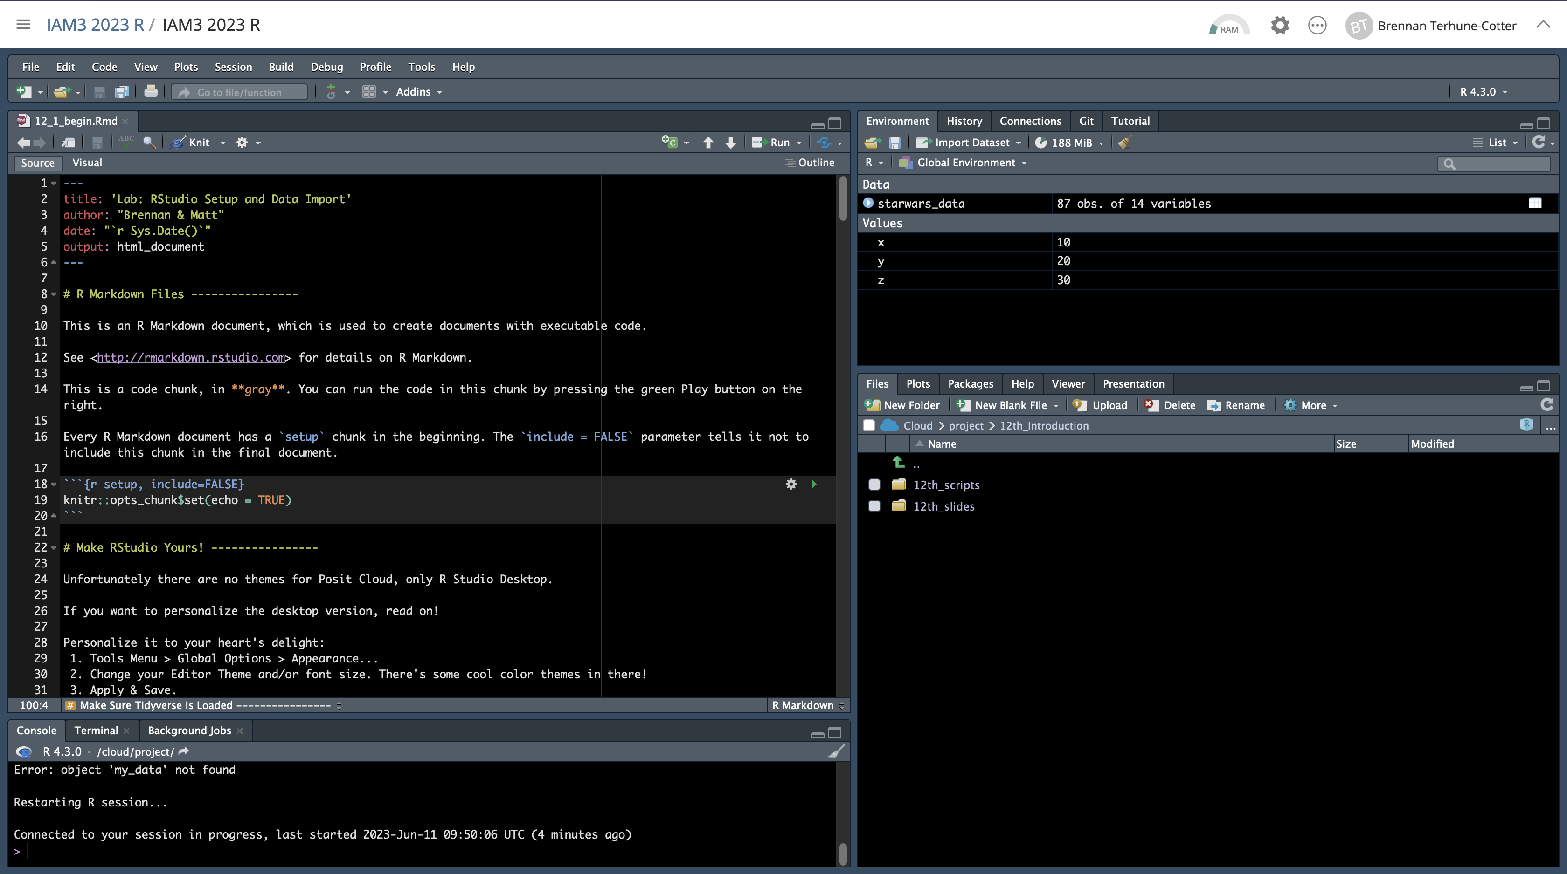
Posit Cloud

Slide 5
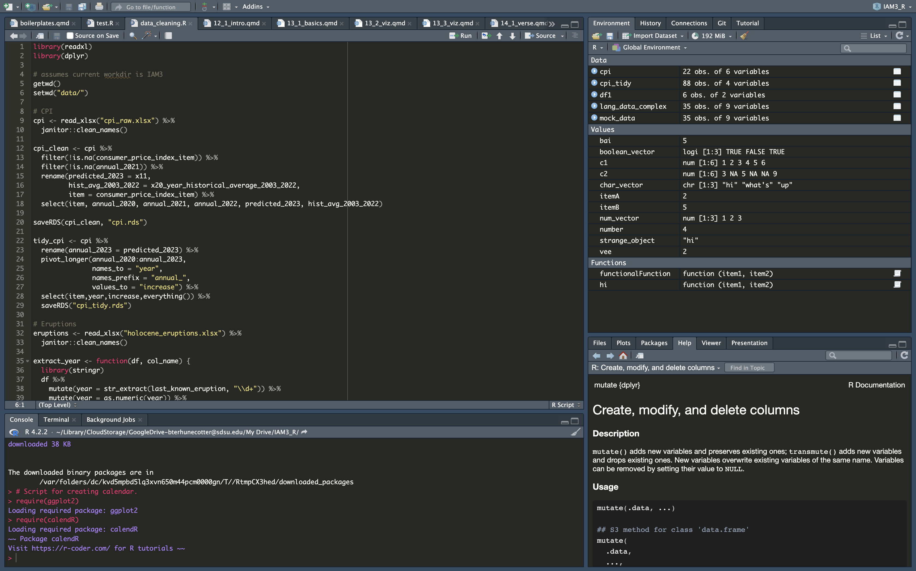
Posit RStudio (Desktop)

Slide 6
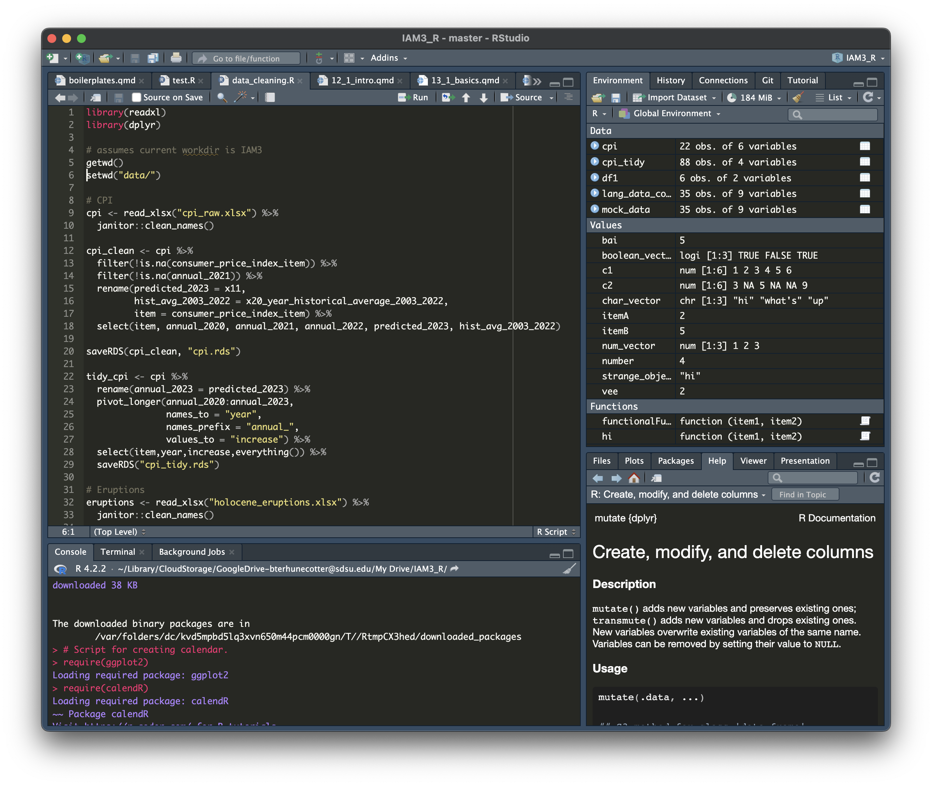
Your open files (scripts, data frames, documents, etc.)
The source: where you’ll do 99% of your coding
The console: displays errors and output; write one-time commands
Displays all objects in your environment
Displays help documentation for functions, or plots, or other things

Slide 7
Source
Source is where you add code to your script(s).
It works like any document: you write code, Save As a file, and save as often as possible ☺
You also will want to run code you write here pretty often

Slide 8
Console
Console shows you the output of all code you run, including source code
When your code doesn’t work, error messages show up in the console.
Caution! Error messages can be frustrating and do not tell you the real problem with the code. They just tell you what the computer noticed.
You can also type and run “temporary” code in the console.

Slide 9
Environment
Environment shows all active objects and custom functions in your global environment
This is critical to understanding what your code has access to!
History shows your command history (I’ve never used this)
(I’ve never used Packages, Viewer, or Presentations)

Slide 10
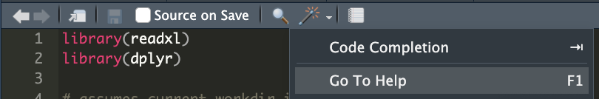
Files/Plots/Help
Files displays the files in your working directory (current folder)
Plots displays plots when you generate them
Help displays documentation for functions
Very useful!!
Press F1 or magic wand -> Go To Help when your text cursor (|) is on a function name:
OR search for a function in the search box
(I’ve never used Packages, Viewer, or Presentations)

Slide 11
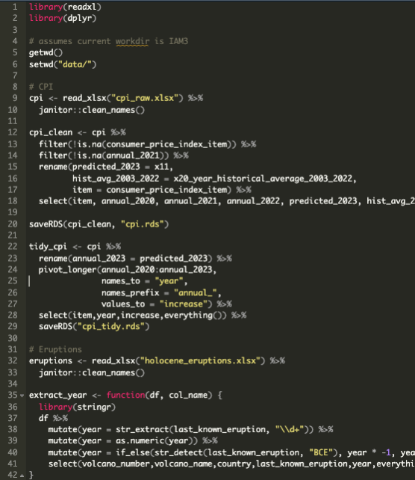
R Scripts
Scripts have code which can be executed
R scripts end with an ‘.R’ extension
Everything in an R script will be executed unless it is commented out with # at the beginning of the line

Slide 12
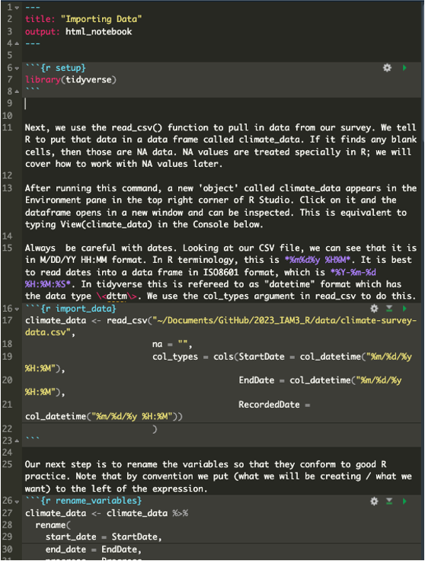
R Markdown
RStudio also provides R Markdown/Notebook documents (“.Rmd”)
Rmd files are text files that contain executable code chunks
Better when you want to type a lot of non-code text
No need to comment out everything!

Slide 13
Running Source Code in R Scripts
You run source code in R scripts by:
Pressing CMD-ENTER (or CTRL-ENTER for PC)
Runs the line of code your text cursor is on
Highlighting code and pressing CMD-ENTER
Runs everything you highlighted
If you want to run the entire script:
CMD-A then CMD-ENTER
If you accidentally press ENTER and erase everything, CMD-Z!

Slide 14
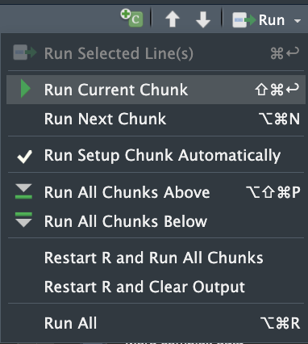
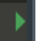
Running Source Code in R Markdown
.Rmd documents have code in chunks.
Run code in a chunk by pressing
You can also run chunks in different ways ->

Slide 15
Running Console Code
Coding in the console works like in any console: you type out your command and press Enter ☺
You type in the line starting with >
Meant to be for one-time code only
Viewing data
Doing calculations
Checking things before adding to source

Slide 16
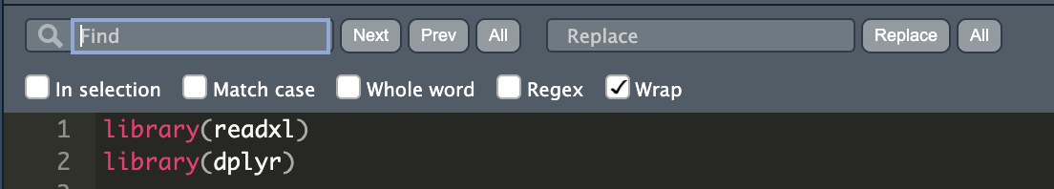
RStudio Tips
Their find and replace function is excellent
CMD-F on Mac | CTRL-F on PC
Find specific text (names, etc.) and replace one or all
CMD-Z | CTRL-Z will undo replacements

Slide 17
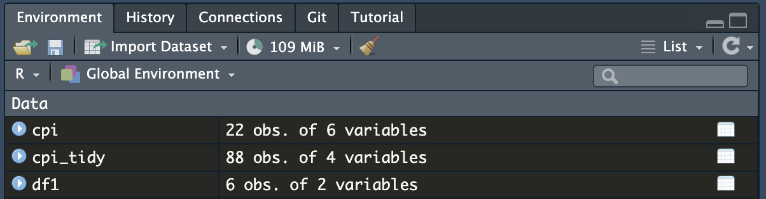
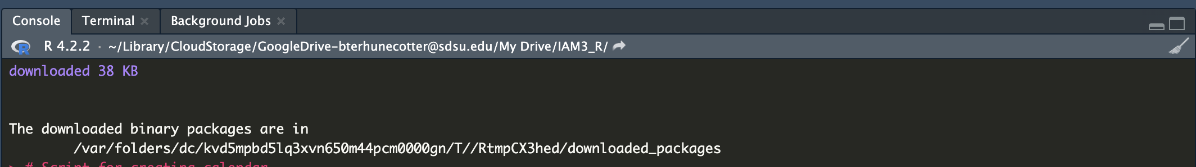
RStudio Tips
The broom icon will wipe clean your environment or your console history.
For your environment: this is important to make sure your script doesn’t call “leftover” objects which should not exist at that point in the script.
For your console history: it will just keep you sane ☺

Slide 18
RStudio Tips
To ensure you don’t end up with a broken script, do this semi-frequently:
Broom up everything in the Environment (and Console if you want, but don’t need)
Re-run your entire script:
Press CMD-A (highlights everything)
Press CMD-ENTER
Fix the error that pops up and do steps 1-2 again
You’re done when everything runs correctly ☺
This can be super annoying, but is critical to catching errors early
The more often you do it, the less annoying it is because you know where the errors are

Slide 19
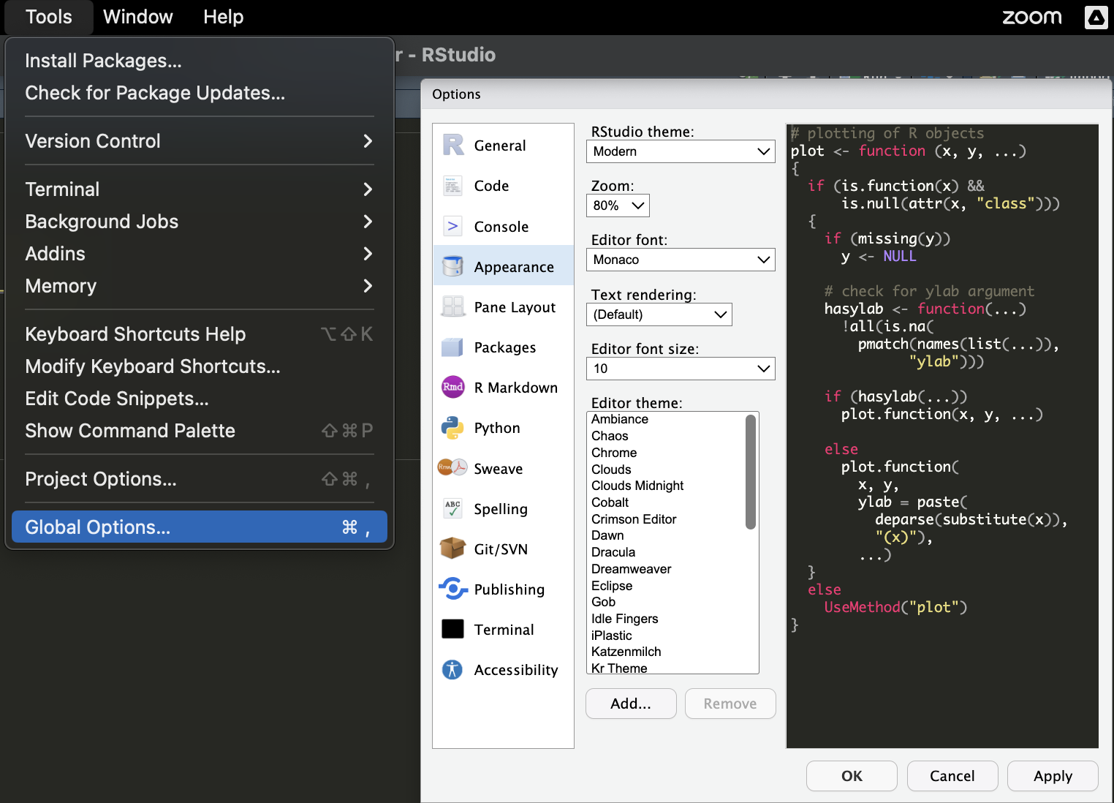
Picking an RStudio & Posit Cloud color theme!
You won’t be a good coder if your screen doesn’t look cool!
Click on Tools > Global Options > Appearance and pick your favorite theme.
There are light and dark themes
I like Monokai and Tomorrow Night; choose whatever you think is prettiest! ☺

Slide 20
Side Note…
RStudio is not the only IDE for R
Another good one is Visual Studio Code (VSC)
VSC is a great IDE for multiple programming languages
It is not specialized for R, but it is very polished and has cool features for programming.
GitHub Copilot (AI to help autocomplete code)
I don’t recommend VSC for learning R but if you want to use other languages or explore more features, check it out!

Slide 21
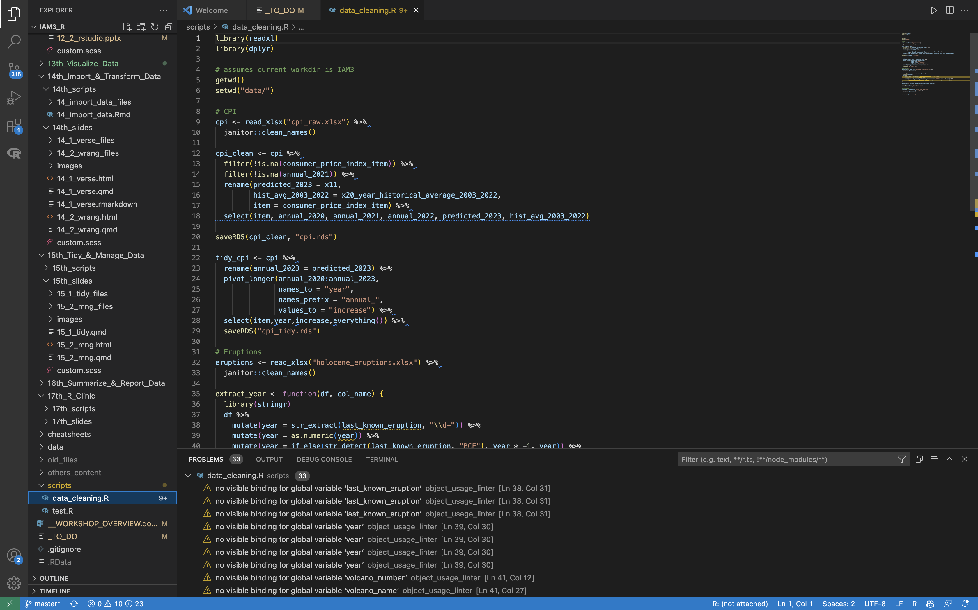
Visual Studio Code

Slide 22
Next up…
We will tell you how to import files into RStudio
Then you will try importing your (or our) data into RStudio!

